Slide 1
Intro to R: Data Science & Visualization Session 3
Prepared by/ omnia Abdelnasser

Slide 2
Data frames
A data frame is essentially a matrix where the columns can have different data types.
We can create data frames by combing already existing vectors using the function data.frame()
E.g.
> organism <- c("human", "chimp", "yeast")
> chromosome <- c(23, 24, 16)
> multicellular <- c(TRUE, TRUE, FALSE)
> organismtable <- data.frame(organism, chromosome, multicellular)

Slide 3
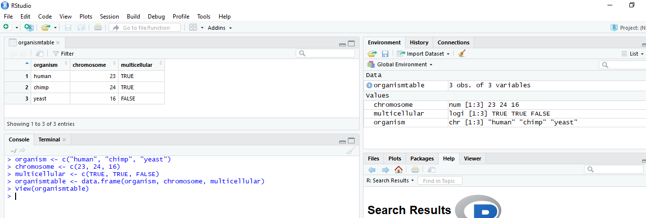
Data frames

Slide 4
How to access data Frames
Columns and rows can be accessed by their names or index by specifying the number or the name of the columns or the row or both of them or using the $ sing
E.g.
organismtable[1,1] => before the coma is the index of the rows and after the coma is the index of the columns which mean what is the element in the first row and the first column.
organismtable[1:2,1] we can use the sign : to specify more than one row or column in this example from row 1 to row 2 and the first column
organismtable$chromosome

Slide 5
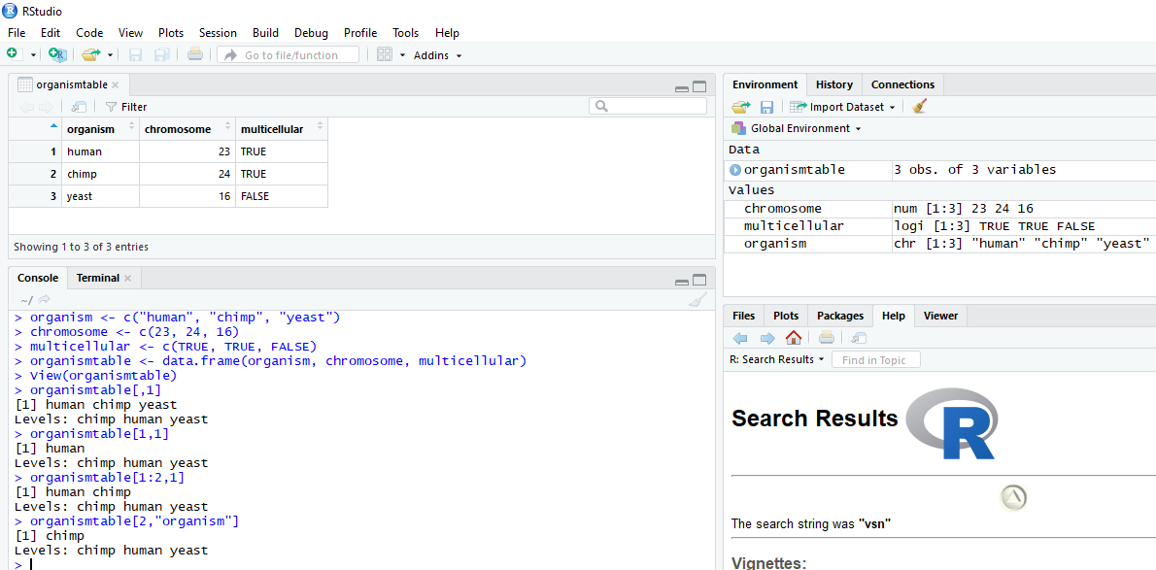
How to access data Frames

Slide 6
Data frames (merging and ordering)
Using merge() function; the first two arguments are the dataframes, then we can specify the column to merge by with by argument
e.g. Merged <- merge(df1, df2, by=1, all=F)
To order a vector or dataframe or matrix we can use order() function
e.g. testorder <- c(50,10,40)
--- Order(testorder, decreasing =T)

Slide 7
Reading data In R
read.table(): read.table() is a general function that can be used to read a file in table format. The data will be imported as a data frame.
Some arguments:
file: the path to the file containing the data to be imported into R.
header: logical value. If TRUE, read.table() assumes that your file has a header row, so row 1 is the name of each column. If that’s not the case, you can add the argument header = FALSE.
sep: the field separator character
row.names: number of column to set as row names.

Slide 8
Reading data In R
read.table(): read.table() is a general function that can be used to read a file in table format. The data will be imported as a data frame.
Some arguments:
check.names: logical. If TRUE then the names of the variables in the data frame are checked to ensure that they are syntactically valid variable names. If necessary, they are adjusted (by make.names) so that they are, and to ensure that there are no duplicates.
Skip: integer: the number of lines of the data file to skip before beginning to read data.
Comment.char: character: a character vector of length one containing a single character or an empty string. Use "" to turn off the interpretation of comments altogether.
geneExpression <-read.table("data/GeneExpressionWithMethods.txt",h=T,sep="\t",row.names=1,skip=3)

Slide 9
Writing data In R
write.table(): is a general function that can be used to write file in text format.
Some arguments:
Sep: the field separator string. Values within each row of x are separated by this string.
Row.names: either a logical value indicating whether the row names of x are to be written along with x, or a character vector of row names to be written.
Col.names: either a logical value indicating whether the column names of x are to be written along with x, or a character vector of column names to be written.
write.table(expressionDF,"orderedExpression.txt",sep=",",col.names = T,row.names=F)
To write csv file you can use write.csv() function

Slide 10
Basic plotting in R
1- You can summarize some data statistics using summary() function
2- hist() function could be used to plot a histogram of the data
Some arguments:
X: the data
Col: a colour to be used to fill the bars
main, xlab, ylab: main title and axis labels
xlim, ylim: the range of x and y values with sensible defaults.
hist(as.matrix(timeCourse)[,4:5],main = "Treatment",xlab = "Treatment")

Slide 11
Basic plotting in R
3- barplot() function could be used to plot a bar plot
Some arguments:
X: the data
Col: a colour to be used to fill the bars
main, xlab, ylab: main title and axis labels
xlim, ylim: the range of x and y values with sensible defaults.
names.arg: a vector of names to be plotted below each bar or group of bars.
beside: a logical value. If FALSE, the columns of height are portrayed as stacked bars, and if TRUE the columns are portrayed as juxtaposed bars.
Bouns: how to plot the bars horizontally?
barplot(control1,names.arg = timeCourse[,1],xlab = "Time")

Slide 12
Basic plotting in R
3- boxplot() function could be used to plot a box plot
Some arguments:
X: the data or formula
Col: a colour to be used to fill the bars
main, xlab, ylab: main title and axis labels
Border: an optional vector of colors for the outlines of the boxplots.
Notch: You want to add notches to a box plot to assess whether the medians are different.
Horizontal: plot the boxplot horizontally?
boxplot(as.matrix(timeCourse[,2:5]), notch=T)

Slide 13
Basic plotting in R
4- to plot line graph we can use plot() and lines()
Some arguments:
x, y: coordinate vectors of points to join.
Col: a colour to be used to fill the bars
main, xlab, ylab: main title and axis labels
xlim, ylim: the range of x and y values with sensible defaults.
type: character indicating the type of plotting "p" for points, "l" for lines, "b" for both points and lines, "c" for empty points joined by lines, "o" for overplotted points and lines, "s" and "S" for stair steps and "h" for histogram-like vertical lines. Finally, "n" does not produce any points or lines.
lwd: line width
Pch: shape of the points
Bonus: how to draw many plots in one graph?

